Slide 1




-Team X Æ A-12

Slide 2
Meet our team
Karan Jain
kjain@iitg.ac.in
Kshitij Arora
k.arora@iitg.ac.in
Shikshanshu Shekhar Jha
shikshanshu.shekhar@iitg.ac.in
Saravanan Venkateshwaran
svenkateshwaran@iitg.ac.in

Slide 3
Big concept
NFTs are tokens that we can use to represent ownership of unique items. They can only have one official owner at a time and they're secured by the Solana Blockchain
We aim to provide a place where people can efficiently use the NFTs owned by them in various ways like trading and using as collateral for loans

Slide 4



Our approach
Renting NFT
Users will be allowed to rent their NFT’s. This opens the avenue for users to temporarily use an NFT they otherwise do not want to purchase, for a set time period
NFT Market
Enabling the users to list their NFT’s on our marketplace, thereby enabling all the users to buy the NFT or a fraction of it.
Loans against NFT
Put your NFT assets up as collateral for a loan, or offer loans to other users on their non-fungible tokens

Slide 5



Benefits of used Technologies
SOLANA
FLUTTER
STARDUST
In a marketplace, where prices fluctuate at high speeds, having a fast, secure and reliable blockchain network is essential. Solana is the perfect choice as it fulfills all the requirements.
Flutter is used as a cross platform tool to develop the android and ios application connected with Node.js API for retrieving data from the database.
Stardust allows the developer to easily create the NFT featuare in the Solana application. It’s robust transaction system makes the application secure.

Slide 6
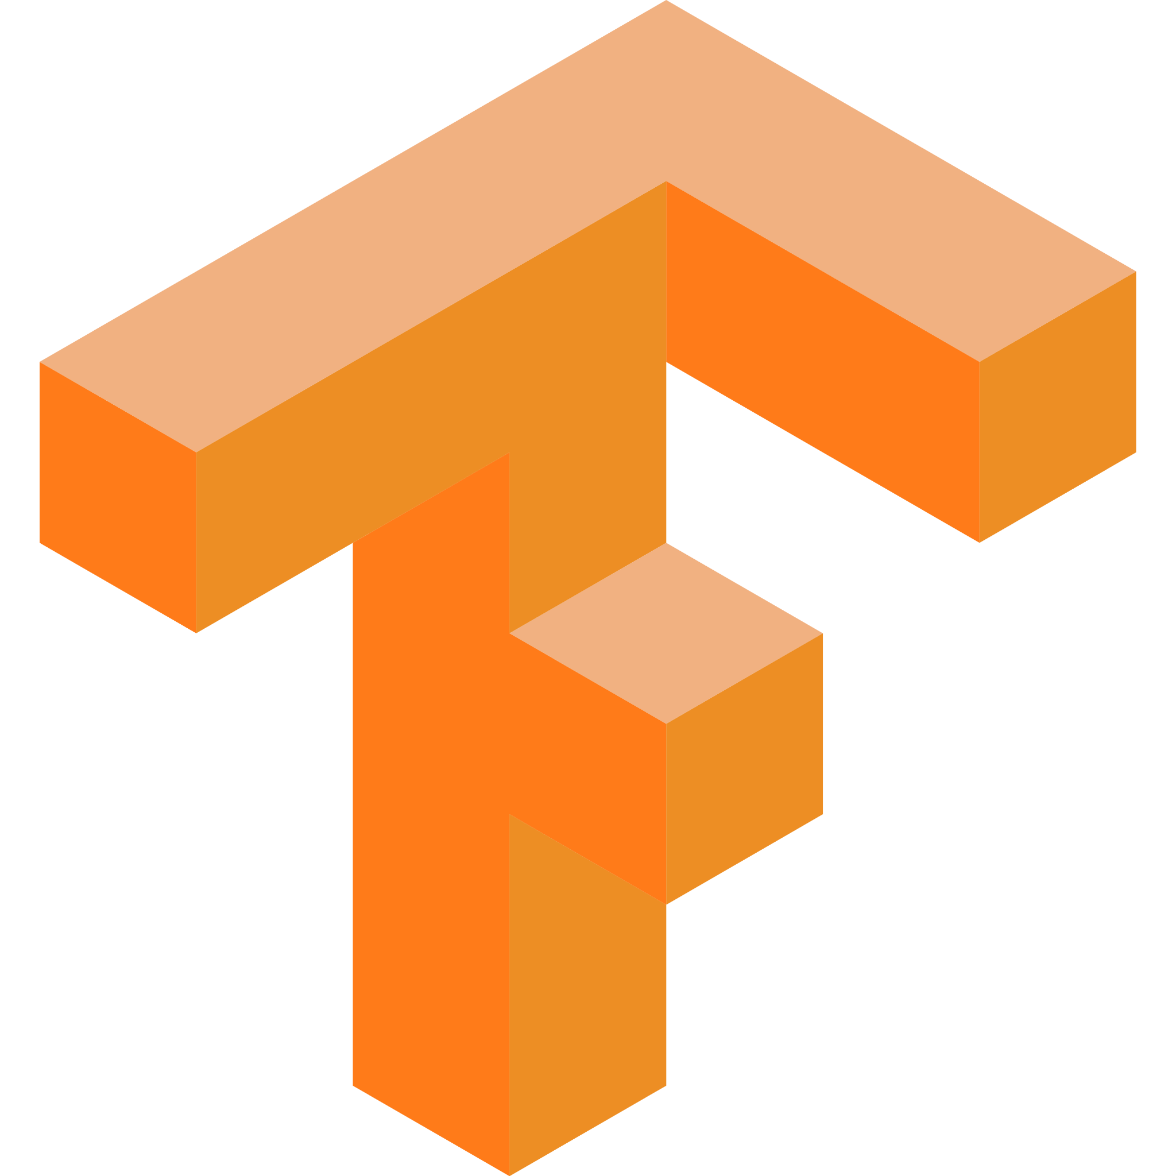
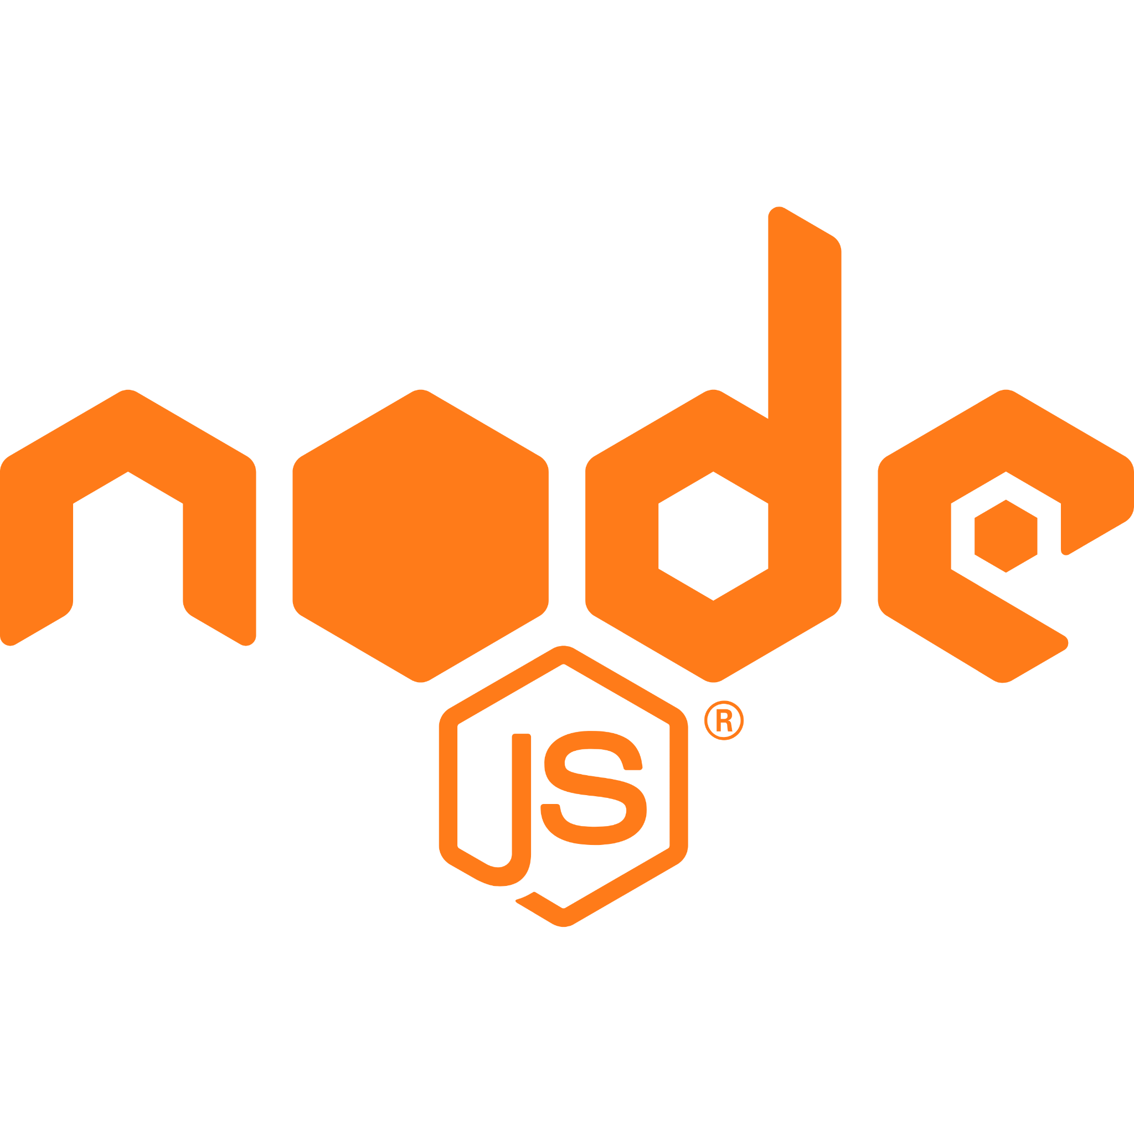







Tech Stack
Solana
Stardust
Rust
Kotlin
Python
Flutter
MongoDB
Tensorflow
Node.js
Scikit-Learn

Slide 7
Key features
Fractionalising NFT
users will be able to fractionalize entire collections of NFTs by minting 100 of them as template for the same item and release them under collection-specific fractional ownership tokens
This would the help the users with
Price Discovery
Liquidity
Curator Fees

Slide 8
Key features
NFT Stock market
Users can trade NFTs or fraction of NFTs in a peer to peer fashion like the stock market . NFTs become a compelling investment opportunity when you consider the art’s resale value.
This provides the avenue for low-interval high-return use for NFTs.

Slide 9
Key features
Peer to peer NFT Renting
Now users can temporarily use an NFT for a set period of time using our Renting feature.
By the feature of renting the owner will transfer the NFT to our smart contract to list it for rent.
Here the Owner specifies the daily rental price , full price of NFT and maximum number of days they want to lend the NFT . The borrower will specify the days they want to rent the NFT and the respective rent price will be transferred to owner’s account immediately and the full price of NFT will be stored as a collateral in our contract and returned to borrower upon return of NFT.

Slide 10
Key features
Using NFT’s as collateral for loan.
When you list any NFT as collateral , other users can offer you a loan against it. Once you accept the loan , SOL gets transferred to you from lenders account and the NFT is locked in our smart contract.
Once you repay the loan in stipulated time frame the asset will be return to borrower however in the case the borrower fails to repay the loan , the asset is transferred to lender.
Small, short term loans to other people can offer attractive returns.

Slide 11
Key features
Prediction and boost
We will use the past data of and the properties of NFT to predict the Future prices of the NFT to help the users in trading efficiently.
We also provide the option to boost one’s NFT -ie- prioritise the NFT in explore page to help the user with sales

Slide 12
Thank you

